Slide 1
Morgan Stanley Hack-A-Thon
Marist College
Friday, May 3rd, 2013

Slide 2
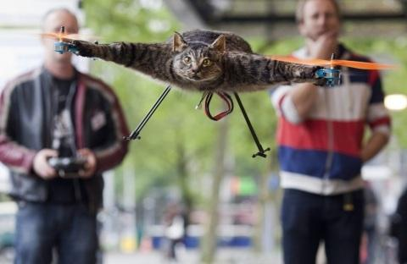
Welcome
You are making history!
Tackle a challenge we at Morgan Stanley face today!
Unleash your creative side!
Have fun!

Slide 3
The Contest
48-hour programming challenge for groups of up to four students
  problem solving
  coding
  algorithm design
  time management
Challenge is based on a real-world problem
Top 3 teams will present their projects for a final showdown (with a twist)

Slide 4
The Prizes
First place:
  GitHub Silver Membership for 1 year
  Come meet the EI CTO team in NY (travel expenses paid)
    Join us for a tech talk with Bjarne Stroustrup (created/developer of C++)
  Tour of the Innovation Lab
  Tour of our trading floor
Second place:
  GitHub Bronze Membership for 1 year
  Choice of 2/3 MS prizes
Third place:
  GitHub Silver Membership for 6 months
  Choice of 1/3 MS prizes
(Thanks Travis Beatty for getting the GitHub prizes!)

Slide 5
The Challenge
Banks need to react ever-faster to changing business opportunities
  Deploy technology to address client demand whenever and wherever it occurs.
In the past, applications have been deployed on a fixed number of physical servers, in specific locations (e.g. New York City).
Newer applications are adopting component-based ‘Service Oriented Architecture’ (SOA) design patterns
  Application is decomposed into multiple different tiers, each running on physical or virtual servers.

Slide 6

You will work with Hermes
The Greek god of boundaries, travel, communication and trade
Hermes is a fictitious trading application that runs in North America (NA), Europe (EU), and Asia-Pacific (AP), and is built on a three-tier SOA architecture
Handles transactions from clients on a 24x7 non-stop basis
The application has a Web layer, a Java layer and a Database layer, comprised of virtual machines running in the three trading regions

Slide 7





The Global Trading Scenario
North America
Europe
Asia-Pacific
Clients
70%
50%
70%
100%
50%
50%
50%
100%
100%
Web Tier
0-180 = 100%, 181-200 = 90%, 201-250 = 20%, 250+ = 0%
Java Tier
0 – 400 = 100%, 401 – 500 = 90%, 501 – 600 = 20%, 601+ = 0%
Database Tier
0 – 1000 = 100%, 1001 – 1200 = 90%, 1201 – 1400 = 20%, 1401+ = 0%
80%
70%
Triple-site Split = 39%
70%

Slide 8
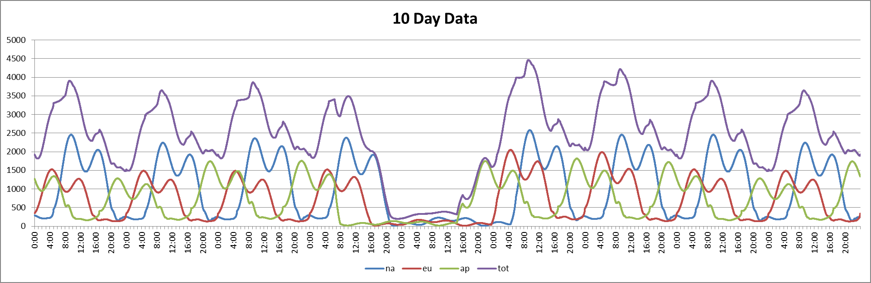
Typical Trading Period: 10 Days

Slide 9
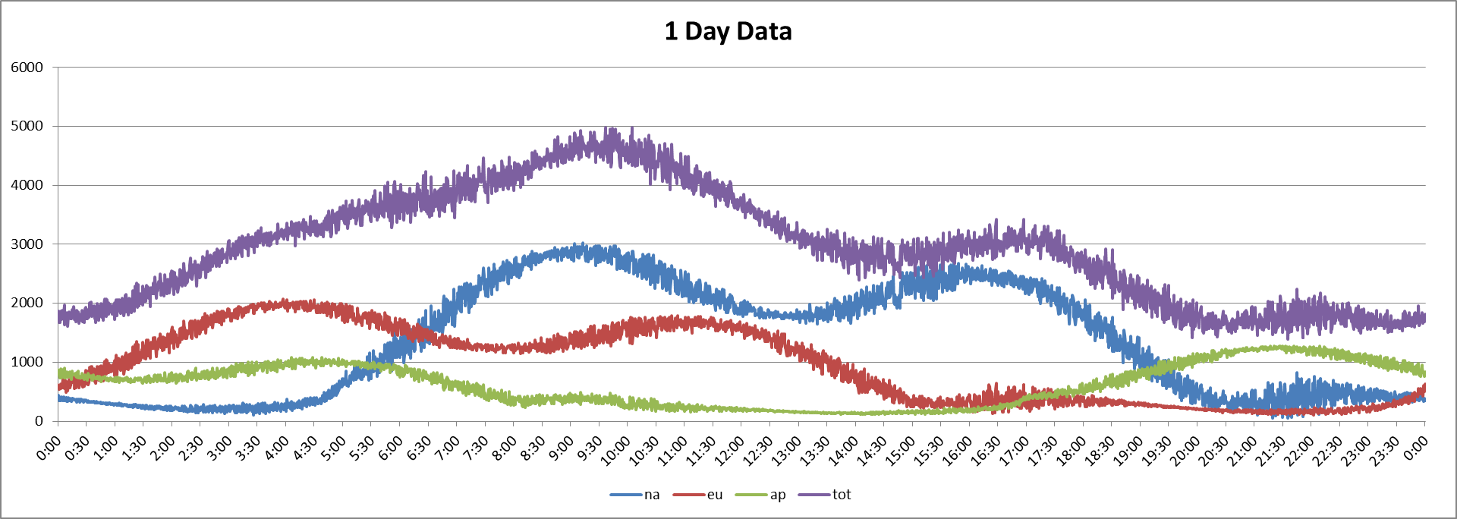
Typical Trading Period: 1 Day

Slide 10
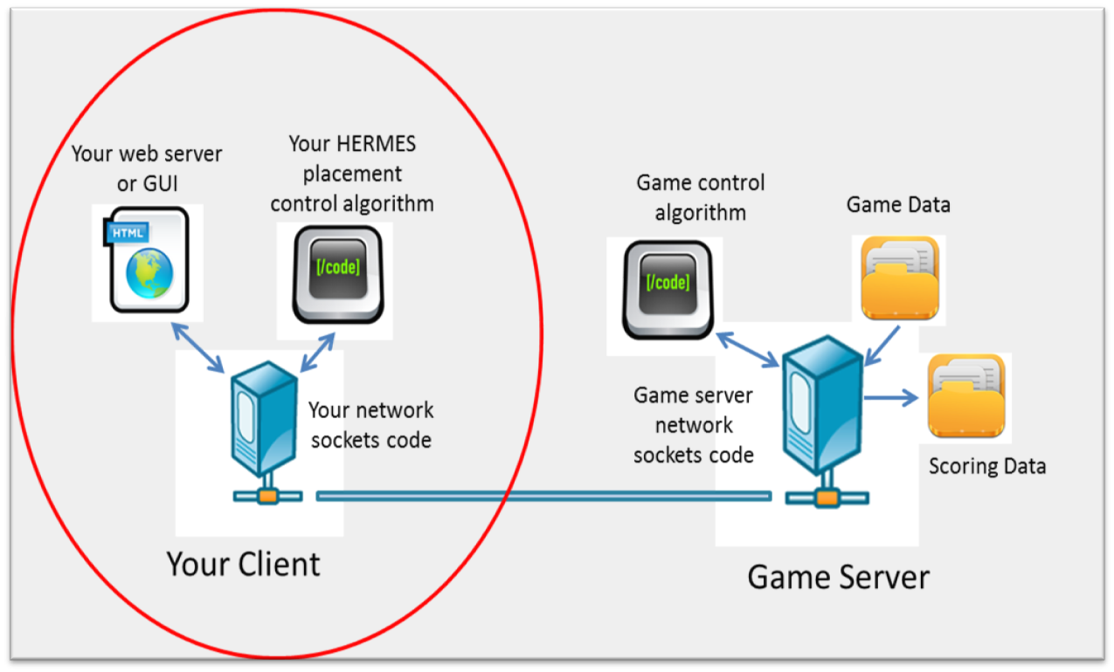
Client/Server Interaction

Slide 11
Key things to keep in mind
Goal is to find the optimal number of web, java and database servers based on change in trade demand
Bringing servers up or down takes a few game turns
May be more profitable to have a trade “fail” over to another region as oppose to bringing up another server
Different trading climates may call for either a more or less aggressive scaling up/down of your infrastructure. All dependent on the most optimal profit margin
Servers take longer to start vs. bringing them down
  Beware of bringing servers down too early. You may leave yourself with no database server in one region, resulting in 100% trade loss

Slide 12
Suggestions for Plan of Attack
Spend a good amount of time reading the documentation
  Read it a few times over
  Discuss each section with your teammates
  Lay out a project plan for each of the components
Based on the team’s strengths/weaknesses, divide and conquer:
  Have somebody code the GUI or web server
  Have somebody work on the network programming part
  Have somebody work on the control algorithm and the overall linkage of the components
When you start coding, make sure the basic communication parts of your code works before implementing your strategy
Once you have your basic algorithm logic, start tweaking it and make it more efficient

Slide 13
Hints & Tips
You don’t have to assess the game every turn
  You may want to watch and see what is happening in the market for a few turns before making any changes to the infrastructure
  Once you have a basic logic in place, work towards more granular control to maximize profits
    Look up PID (Proportional, Integral, Derivative) Control Algorithms
Past performance is not an indication of future performance
  You can solely base your logic on time of day for each region, but beware of unexpected spikes caused by global external factors
Make sure you are managing your time efficiently
Save your work early and often

Slide 14
Schedule
Friday 7pm
  kick-off
Saturday Checkpoint (up to participants)
  Morgan Stanley technology team will be available in Hancock Lab to answer questions
Sunday 4 - 6pm
  Teams can submit project for judging
  First round of judging ends at 6pm
  Top 3 teams present their project and do a real-time demo (with a twist)

Slide 15
Contact Us
Team from Morgan Stanley are:
  Leonardo Mordasini, EI CTO’s office, Innovation Program Lead, New York
  Ryan Kupfer, Virtualization Engineering, New York
Questions during the event, send an e-mail to either
  Leonardo.Mordasini@Gmail.com
  Ryan.Kupfer@MorganStanley.com
Announcements will be sent to all of your team members using the e-mail address they gave when registering

Slide 16

Final Remarks

Slide 17
Appendix

Slide 18
Client Game Server
Initial Network Protocol Conversation
…
Waiting for client connection
INIT [Team RedFoxes]
Connection Accepted
ACKNOWLEDGED
COSTS
Cost for each server per 30 second ‘game turn’
START GAME

Slide 19
Game Loop
Client Game Server
CONFIG
{W-NA} {W-EU} {W-AP}
{J-NA} {J-EU} {J-AP}
{D-NA} {D-EU} {D-AP}
ACKNOWLEDGED
OR
END
STOP

Slide 20
Client Game Server
Exchange of Information
DEMAND
# of trade transactions that came in the previous turn per region
ACKNOWLEDGED
DISTRIBUTION
# of successful transactions for each tier and region for previous turn.
ACKNOWLEDGED

Slide 21
Client Game Server
Control Algorithm
PROFIT
How much money you are making
CONTROL
{-1}{0} {2}
{0} {0} { 1}
{0} {0} {1}
REPEAT GAME LOOP

